Slide 1
Blockchain Project Management
Presented by : Ravikumar Panchal

Slide 2
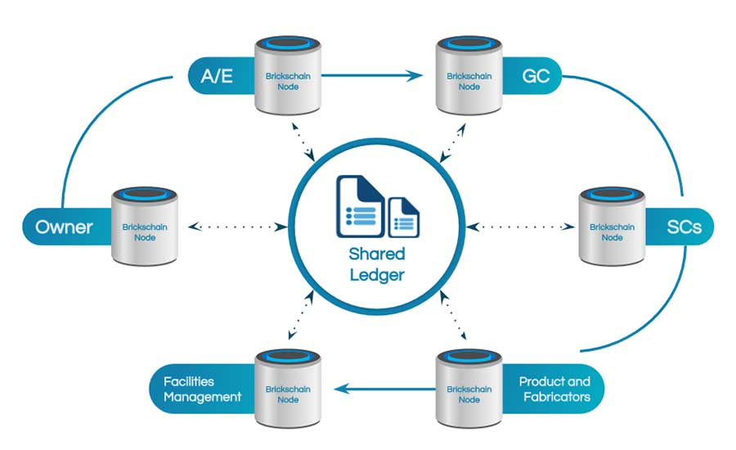
outline
Definition
Technology awareness
Needs of blockchain technology
Working of blockchain technology in project management
Future of blockchain technology
References

Slide 3
Definition
Blockchain project management refers to the application of blockchain technology in the field of project management.
Traditional project management involves processes such as planning, execution, monitoring, and closing of projects.
Blockchain, on the other hand, is a decentralized and distributed ledger technology that ensures transparency, security, and immutability of data.
When these two concepts come together, blockchain project management typically involves using blockchain to enhance various aspects of project management.
Overall, blockchain project management aims to improve efficiency, transparency, and trust in project workflows.

Slide 4
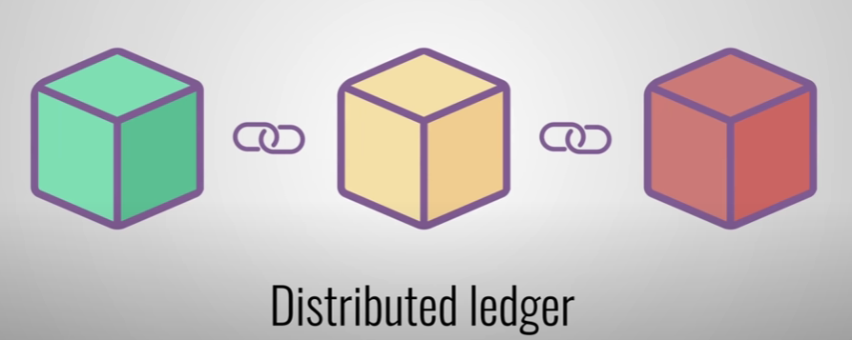
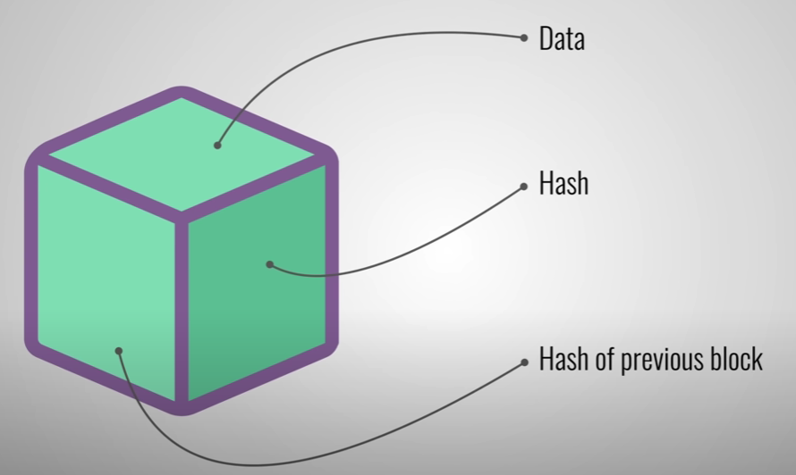
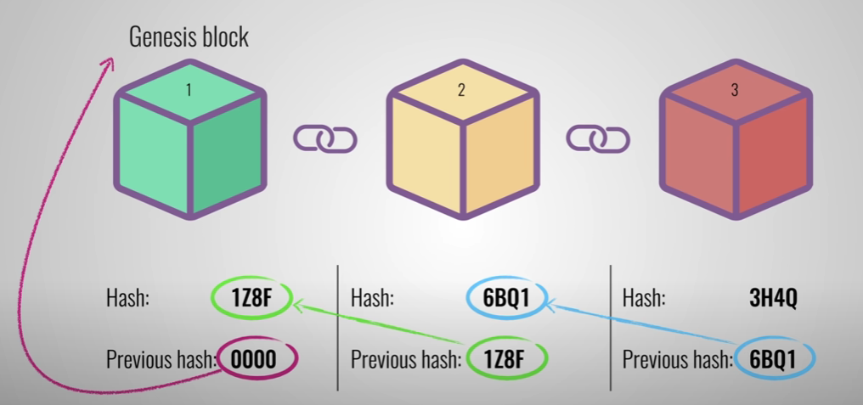
Blockchain technology awareness

Slide 5
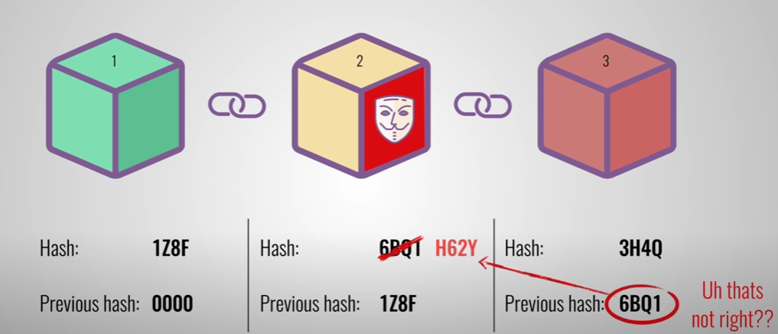
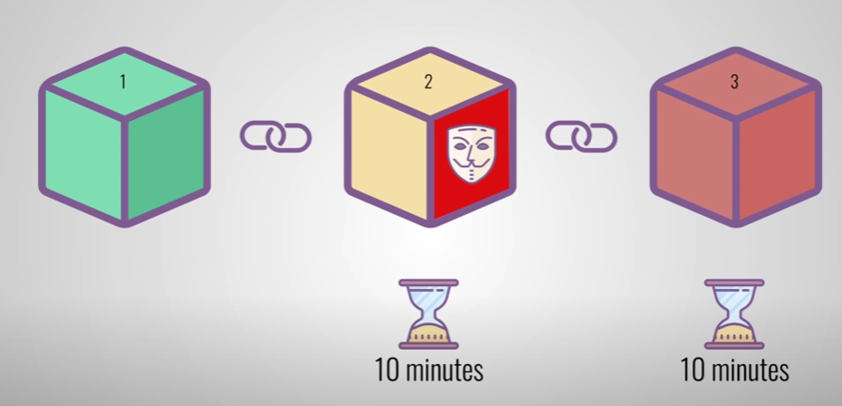
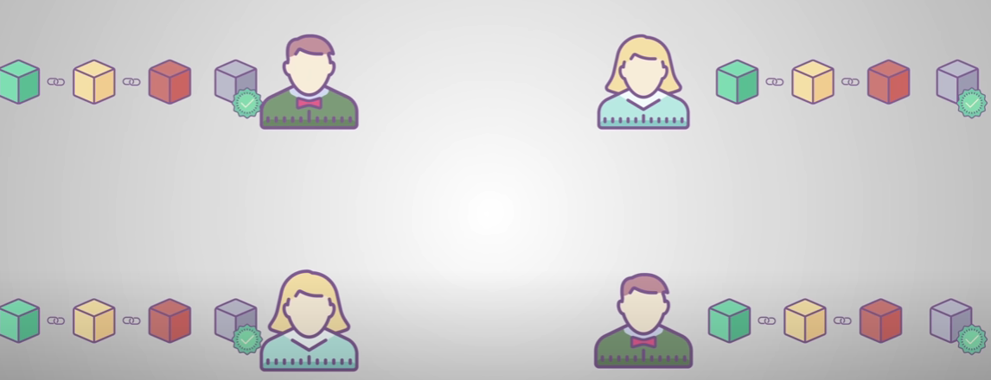
Blockchain technology awareness
PROOF OF WORK
P2 P NETWORK

Slide 6
Need of blockchain in project management
1.Transparency and traceability:
Blockchain provides a transparent and traceable record of all transactions or activities within A project.
This can help in tracking the progress of tasks, ensuring accountability, and providing a clear audit trail.
2. Smart contracts:
Smart contracts are self-executing contracts with the terms of the agreement directly written into code.
In project management, smart contracts can automate certain processes, trigger actions based on predefined conditions, and facilitate trust among project stakeholders.

Slide 7
Need of blockchain in project management
3. Decentralization:
Traditional project management systems often involve a central authority overseeing the project.
With blockchain, the information is distributed across a network of nodes, reducing the reliance on a central authority and making the system more resilient and secure.
4. Immutable records:
Once data is recorded on the blockchain, it becomes nearly impossible to alter.
This immutability ensures the integrity of project records and prevents fraudulent activities.
5. Tokenization:
Some blockchain project management systems leverage tokens to represent ownership or value.
This can be used for resource allocation, incentive structures, or even as a form of project currency.

Slide 8
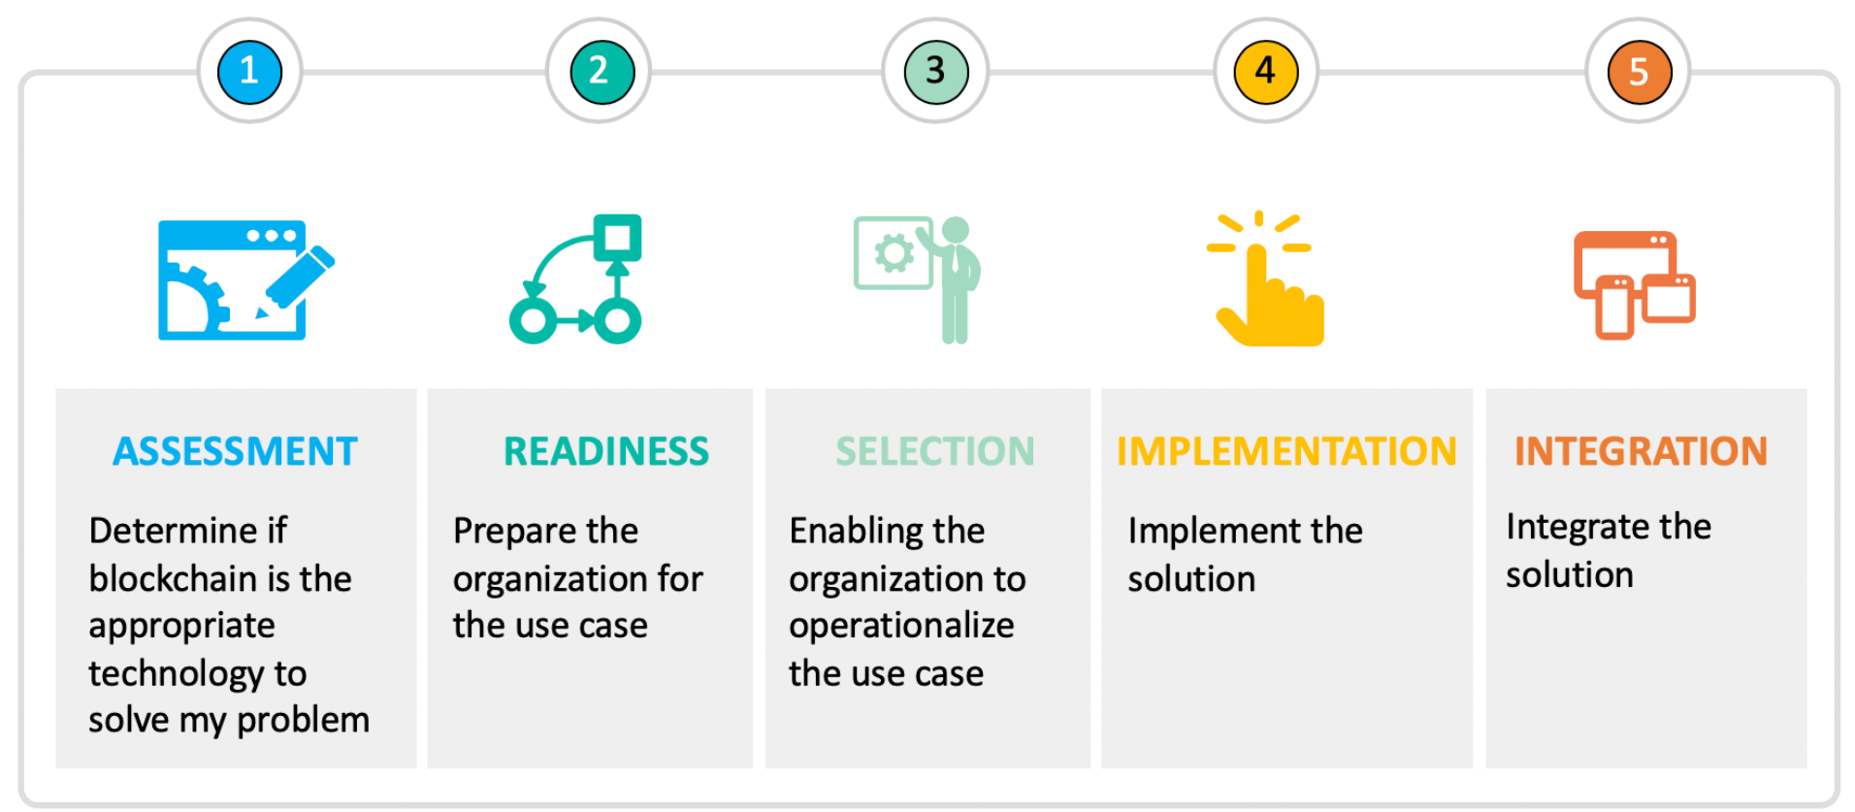
Phases of blockchain technology

Slide 9
Assessment Phase
Evaluating the feasibility, requirements, and potential benefits of implementing blockchain in a particular context.
This phase is crucial for organizations and businesses to determine whether blockchain is a suitable solution for their needs.
Here are the key aspects of the assessment phase in the context of blockchain technology:

Slide 10
Assessment Phase
Identifying use cases:
To identify specific use cases where blockchain can bring value.
It could be improving transparency, reducing fraud, enhancing security, or streamlining processes.
Identifying the right use cases is fundamental to a successful blockchain implementation.
Business requirements:
This involves assessing current processes, identifying pain points, and determining how blockchain can provide solutions or improvements.
Technical feasibility:
Consider factors such as the scalability, security, and interoperability requirements.
Evaluate whether the existing technical infrastructure can integrate with blockchain technology or if adjustments are needed.
Cost-benefit analysis:
To understand the financial implications of implementing blockchain.
This includes upfront development costs, ongoing maintenance expenses, and the potential benefits such as cost savings, efficiency gains, and new revenue streams.

Slide 11
Readiness phase
Refers to the stage where an organization assesses its preparedness to adopt blockchain solutions.
To ensuring that the organization has the necessary resources, infrastructure, and organizational support to successfully implement and integrate blockchain technology.
Here are key considerations during the readiness phase:

Slide 12
Readiness phase
Leadership commitment:
Blockchain adoption often requires significant changes in processes and may face resistance.
Strong support from leadership is crucial for overcoming challenges and driving the initiative forward.
Organizational culture:
Assess the organization's culture and readiness for innovation.
Encourage a mindset of collaboration and experimentation.
Skill assessment:
Determine whether there is a need for additional training or hiring of personnel with expertise in blockchain technology.
Ensure that the team is equipped to develop, implement, and maintain blockchain solutions.
Infrastructure readiness:
Examine the existing IT infrastructure to determine its compatibility with blockchain technology.
Assess whether any upgrades or modifications are necessary to support the deployment of blockchain solutions.
Consider factors such as network capabilities, storage, and computing power.

Slide 13
Selection phase
It involves choosing the specific blockchain platform, protocols, and configurations that align with the identified use cases and organizational requirements.
This phase is crucial for making informed decisions about the technology stack and features that will be implemented.
Here are key considerations during the selection phase:

Slide 14
Selection phase
Regulatory compliance:
Ensure that the selected blockchain platform aligns with regulatory requirements in the industry and region where the organization operates.
Consider features that support compliance, privacy, and data protection regulations.
Tokenization and asset management:
Evaluate how well it supports the creation and management of digital assets and tokens, especially if the use case involves tokenized assets or cryptocurrencies.
Usability and user interface:
Evaluate the usability and user interface of the blockchain platform, especially if non-technical users will interact with it.
User-friendly tools and interfaces can contribute to a smoother adoption process.
Costs and licensing:
Evaluate licensing models, transaction fees, and any other expenses related to development, deployment, and maintenance.

Slide 15
Implementation Phase
It involves putting the chosen blockchain solution into action.
This phase encompasses the actual development, deployment, and integration of the blockchain system into the existing infrastructure.
Here are key aspects to consider during the implementation phase:

Slide 16
Implementation Phase
Development:
This involves writing code, testing, and debugging to ensure that the software functions as intended.
Smart contracts deployment:
Smart contracts are self-executing contracts with the terms of the agreement directly written into code, and they play a crucial role in automating processes on the blockchain.
Integration with existing systems:
Ensure that the blockchain network can communicate seamlessly with other applications and services to enable a smooth flow of data.
User training:
Provide training for users who will interact with the blockchain system.
This includes educating them on how to use blockchain-based applications, access information on the blockchain, and understand any changes to existing workflows.

Slide 17
Integration Phase
It involves connecting the implemented blockchain solution with existing systems, applications, and processes within an organization.
Here are key considerations during the integration phase:

Slide 18
Integration Phase
API integration:
Establish application programming interface (API) connections to enable communication between the blockchain network and other systems.
The exchange of data and transactions between the blockchain and existing applications.
Data integration:
Integrate data from the blockchain system with existing databases and data storage solutions.
Ensure that data flows smoothly between the blockchain and traditional databases to maintain consistency and accuracy.
Identity and access management (iam):
Integrate identity and access management systems to manage user authentication and authorization.
This ensures that users have the appropriate access levels based on their roles and responsibilities.
Legacy system compatibility:
Address compatibility issues with legacy systems, if applicable.
Older systems may have different data formats or communication protocols, and adjustments may be needed to ensure interoperability.

Slide 19
Future of blockchain technology
Finance and banking:
Blockchain is likely to revolutionize the financial sector by providing more efficient and secure payment systems, reducing fraud, and improving transparency. It can streamline cross-border transactions, automate compliance, and facilitate faster settlements.
Supply chain management:
Blockchain can enhance transparency and traceability in supply chains by providing a secure and unalterable record of every transaction and movement of goods. This can help reduce fraud, counterfeiting, and errors in supply chain processes.
Healthcare:
In healthcare, blockchain can improve data interoperability, security, and integrity. Patient records, pharmaceutical supply chains, and clinical trials can benefit from the decentralized and tamper-resistant nature of blockchain technology.

Slide 20
Future of blockchain technology
4. Real estate:
Blockchain can simplify and expedite real estate transactions by providing a transparent and unalterable record of property ownership, reducing fraud, and lowering the cost of intermediaries. Smart contracts can automate and enforce the terms of real estate agreements.
5. Identity management:
Blockchain has the potential to revolutionize identity management by providing a secure and decentralized way to manage digital identities. This could reduce identity theft and streamline identity verification processes across various industries.
6. Energy trading:
Blockchain can enable decentralized and transparent energy trading platforms. It allows for the creation of smart grids where energy producers and consumers can transact directly, optimizing the distribution and consumption of energy.

Slide 21
Future of blockchain technology
7. Education:
Blockchain technology can be used to verify and secure educational credentials, reducing the risk of fraud in the verification process. It can also facilitate the creation of decentralized and transparent educational systems.
8. Legal and governance:
Blockchain can be applied to improve the efficiency and transparency of legal processes, such as contract execution, dispute resolution, and regulatory compliance. Smart contracts can automate and enforce legal agreements.
9. Media and entertainment:
Blockchain can address issues of copyright infringement and royalty distribution in the media and entertainment industry. Smart contracts can automatically enforce copyright agreements and ensure fair compensation for content creators.

Slide 22
References
Borisov, N., Goldberg, I., & Wagner, D. (2001). Intercepting mobile communications. Https://doi.Org/10.1145/381677.381695
Chandramouli, R., Iorga, M., & Chokhani, S. (2013). Cryptographic key management issues and challenges in cloud services. In springer ebooks (pp. 1–30). Https://doi.Org/10.1007/978-1-4614-9278-8_1
Clarkson, P., Li, Y., Richardson, G. D., & Vasvari, F. P. (2008). Revisiting the relation between environmental performance and environmental disclosure: an empirical analysis. Accounting organizations and society, 33(4–5), 303–327. Https://doi.Org/10.1016/j.Aos.2007.05.003
Kosba, A. E., Miller, A. H., Shi, E., Wen, Z., & Papamanthou, C. (2016). Hawk: the blockchain model of cryptography and privacy-preserving smart contracts. Https://doi.Org/10.1109/sp.2016.55
Kshetri, N. (2018). 1 blockchain’s roles in meeting key supply chain management objectives. International journal of information management, 39, 80–89. Https://doi.Org/10.1016/j.Ijinfomgt.2017.12.005
Sicari, S., Rizzardi, A., Grieco, L. A., & Coen-porisini, A. (2015). Security, privacy and trust in internet of things: the road ahead. Computer networks, 76, 146–164. Https://doi.Org/10.1016/j.Comnet.2014.11.008

